Slide 1


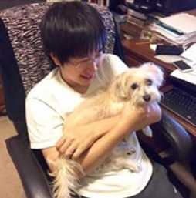
Truly Perfect Samplers for Data Streams and Sliding Windows
Rajesh Jayaram
David P. Woodruff
Samson Zhou

Slide 2

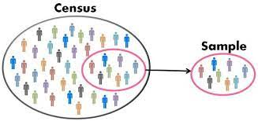




Sampling
Notes:
The sliding window model emphasizes recent data and thus is appropriate for settings that are time sensitive.

Slide 3
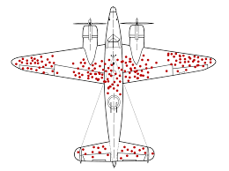
Sampling
Notes:
The sliding window model emphasizes recent data and thus is appropriate for settings that are time sensitive.

Slide 4

Streaming Model
Input: Elements of an underlying data set $S$, which arrives sequentially
Output: Evaluation (or approximation) of a given function
Goal: Use space sublinear in the size $m$of the input $S$
Notes:
Let’s start by breaking down each of the terms in the title. To understand the sliding window model, we first have to understand the streaming model of computation, in which elements of an underlying data set S, arrive sequentially and the goal is to evaluate or approximate some given function on this dataset, using space sublinear in S. In the sliding window model, only the W most recent updates form the underlying data set

Slide 5
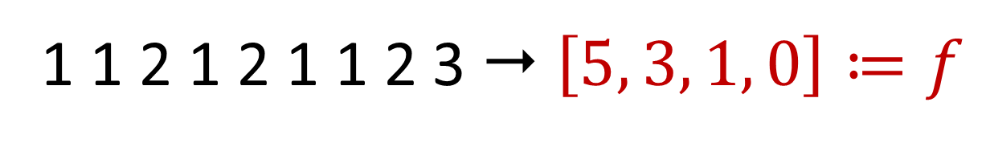

Frequency Vector
Given a set $S$ of $m$ elements from $[n]$, let $f_{i}$ be the frequency of element $i$. (How often it appears)
1 1 2 1 2 1 1 2 3  $\left[5, 3, 1, 0\right]≔f$

Slide 6
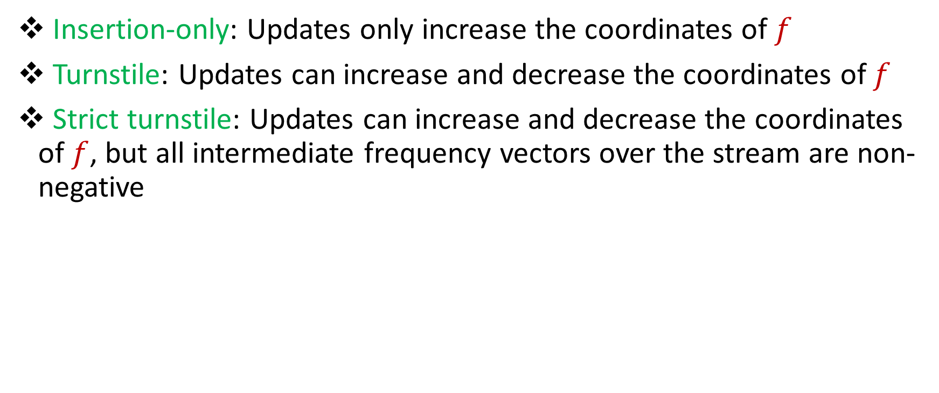
Streaming Model
Insertion-only: Updates only increase the coordinates of $f$
Turnstile: Updates can increase and decrease the coordinates of $f$
Strict turnstile: Updates can increase and decrease the coordinates of $f$, but all intermediate frequency vectors over the stream are non-negative
Notes:
Let’s start by breaking down each of the terms in the title. To understand the sliding window model, we first have to understand the streaming model of computation, in which elements of an underlying data set S, arrive sequentially and the goal is to evaluate or approximate some given function on this dataset, using space sublinear in S. In the sliding window model, only the W most recent updates form the underlying data set

Slide 7
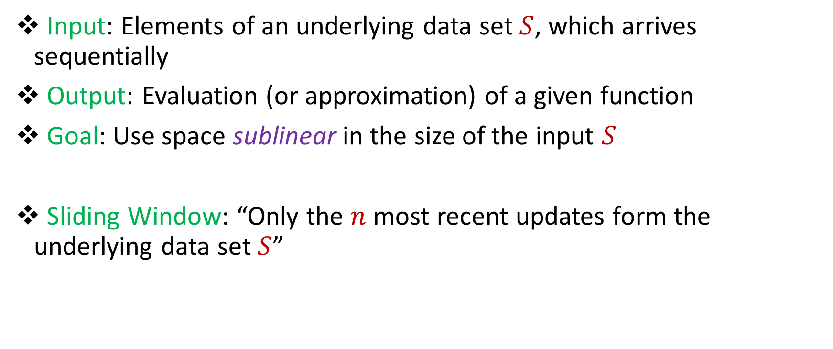
Sliding Window Model
Input: Elements of an underlying data set $S$, which arrives sequentially
Output: Evaluation (or approximation) of a given function
Goal: Use space sublinear in the size of the input $S$
Sliding Window: “Only the $n$ most recent updates form the underlying data set $S$”
1 1 2 1 2 1 1 1

Slide 8
Sliding Window Model
Input: Elements of an underlying data set $S$, which arrives sequentially
Output: Evaluation (or approximation) of a given function
Goal: Use space sublinear in the size of the input $S$
Sliding Window: “Only the $n$ most recent updates form the underlying data set $S$”
1 1 2 1 2 1 1 1 3

Slide 9

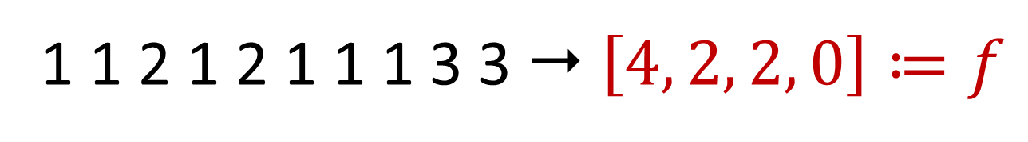
Sliding Window Model
Input: Elements of an underlying data set $S$, which arrives sequentially
Output: Evaluation (or approximation) of a given function
Goal: Use space sublinear in the size of the input $S$
Sliding Window: “Only the $n$ most recent updates form the underlying data set $S$”
Emphasizes recent interactions, appropriate for time sensitive settings
1 1 2 1 2 1 1 1 3 3  $\left[4, 2, 2, 0\right]≔f$
Notes:
The sliding window model emphasizes recent data and thus is appropriate for settings that are time sensitive.

Slide 10
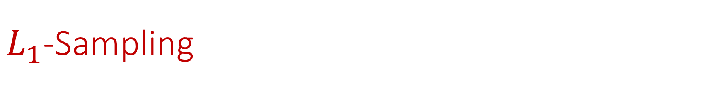
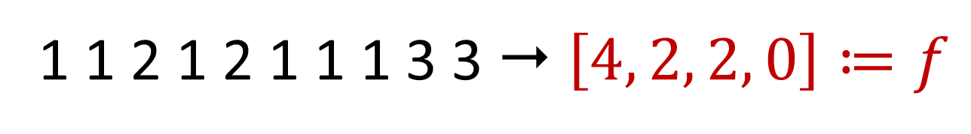

$L_{1}$-Sampling
Sample $i∈[n]$with probability $\frac{{|f}_{i}|}{{\left\|f\right\|}_{1}}$
Output $1$ w.p. $\frac{1}{2}$, $2$ w.p. $\frac{1}{4}$, $3$ w.p. $\frac{1}{4}$, $4$ w.p. $0$
1 1 2 1 2 1 1 1 3 3  $\left[4, 2, 2, 0\right]≔f$
Notes:
The sliding window model emphasizes recent data and thus is appropriate for settings that are time sensitive.

Slide 11
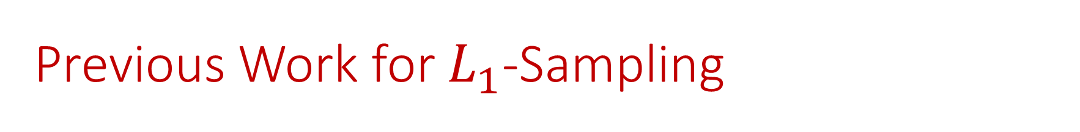
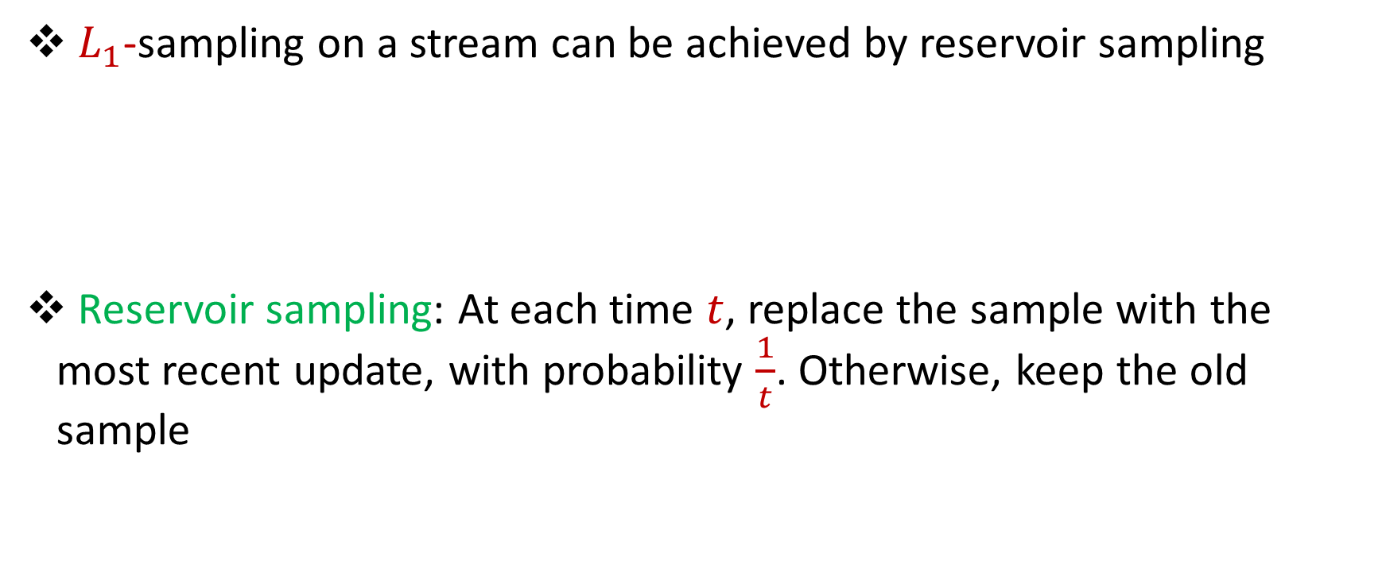
Previous Work for $L_{1}$-Sampling
$L_{1}$-sampling on a stream can be achieved by reservoir sampling
Reservoir sampling: At each time $t$, replace the sample with the most recent update, with probability $\frac{1}{t}$. Otherwise, keep the old sample
Notes:
The sliding window model emphasizes recent data and thus is appropriate for settings that are time sensitive.

Slide 12
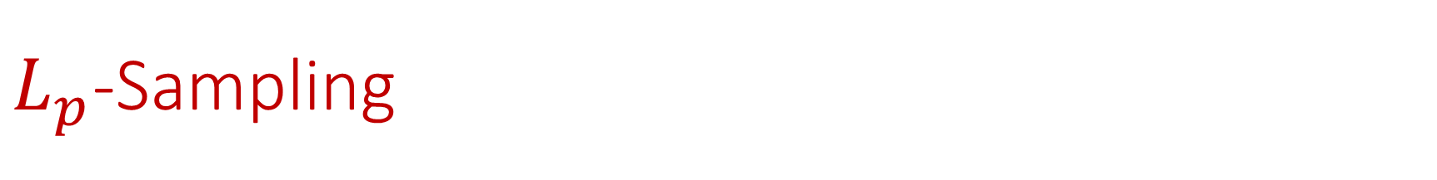
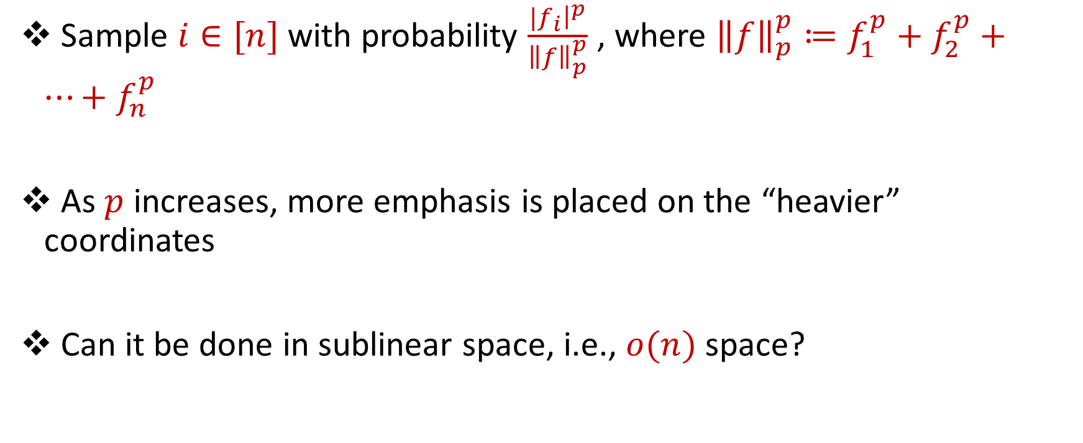
$L_{p}$-Sampling
Sample $i∈[n]$with probability $\frac{{|f}_{i}{\left.​\right|}^{p}}{{\left\|f\right\|}_{p}^{p}}$ , where ${\left\|f\right\|}_{p}^{p}≔f_{1}^{p}+f_{2}^{p}+…+f_{n}^{p}$
As $p$ increases, more emphasis is placed on the “heavier” coordinates
Can it be done in sublinear space, i.e., $o(n)$ space?
Notes:
The sliding window model emphasizes recent data and thus is appropriate for settings that are time sensitive.

Slide 13
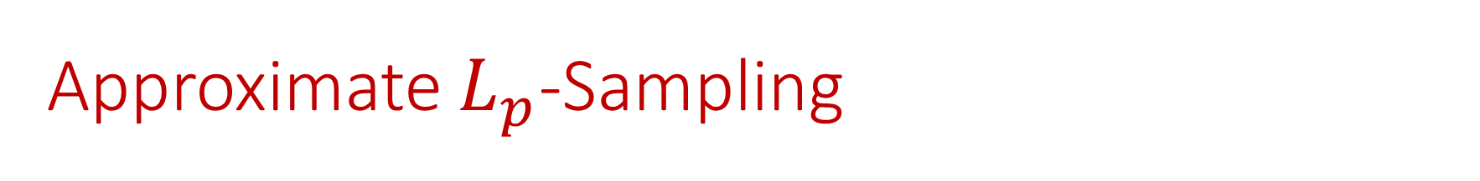

Approximate $L_{p}$-Sampling
Given $ε>0$, sample $i∈[n]$with probability $\left(1+ε\right)\frac{{|f}_{i}{\left.​\right|}^{p}}{{\left\|f\right\|}_{p}^{p}}+\frac{1}{poly(n)}$ , where ${\left\|f\right\|}_{p}^{p}≔f_{1}^{p}+f_{2}^{p}+…+f_{n}^{p}$
Notes:
The sliding window model emphasizes recent data and thus is appropriate for settings that are time sensitive.

Slide 14

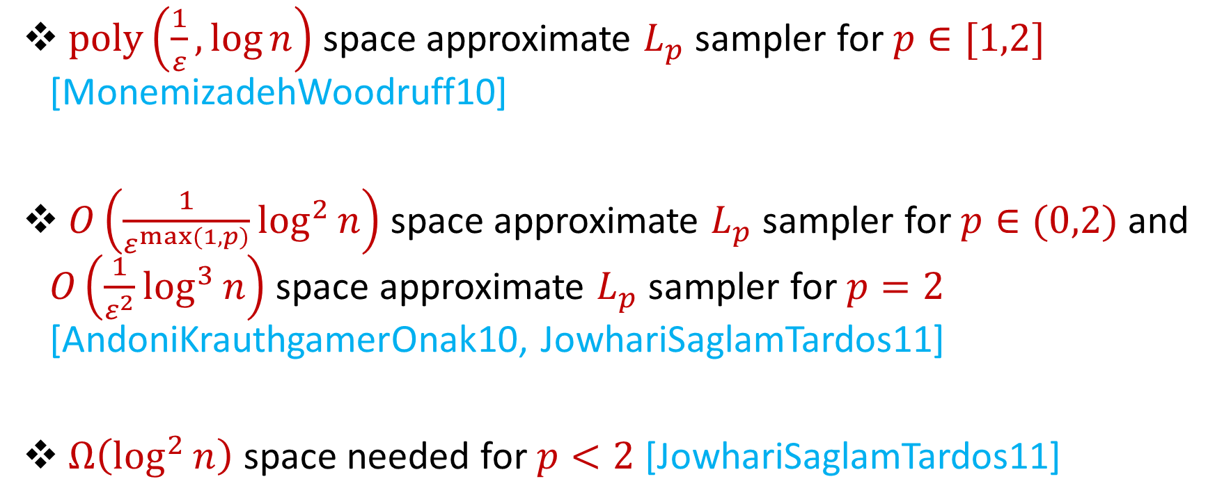
Previous Work for Approximate $L_{p}$-Sampling
$poly\left(\frac{1}{ε},\log{n}\right)$ space approximate $L_{p}$ sampler for $p∈[1,2]$ [MonemizadehWoodruff10]
$O\left(\frac{1}{ε^{\max{(1,p)}}}\log^{2}{n}\right)$ space approximate $L_{p}$ sampler for $p∈(0,2)$ and $O\left(\frac{1}{ε^{2}}\log^{3}{n}\right)$ space approximate $L_{p}$ sampler for $p=2$ [AndoniKrauthgamerOnak10, JowhariSaglamTardos11]
$Ω\left(\log^{2}{n}\right)$ space needed for $p<2$ [JowhariSaglamTardos11]
Notes:
The sliding window model emphasizes recent data and thus is appropriate for settings that are time sensitive.

Slide 15
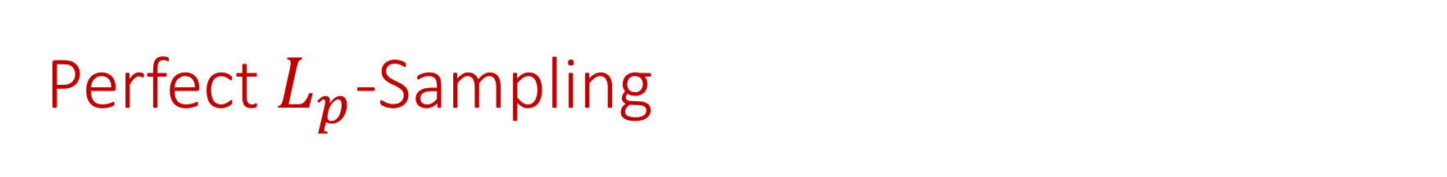
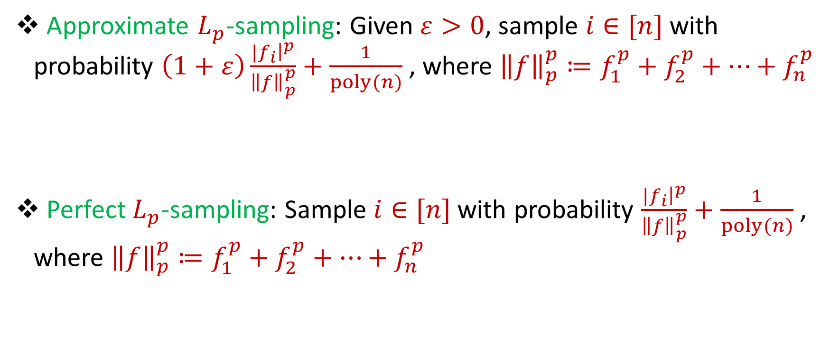
Perfect $L_{p}$-Sampling
Approximate $L_{p}$-sampling: Given $ε>0$, sample $i∈[n]$with probability $\left(1+ε\right)\frac{{|f}_{i}{\left.​\right|}^{p}}{{\left\|f\right\|}_{p}^{p}}+\frac{1}{poly(n)}$ , where ${\left\|f\right\|}_{p}^{p}≔f_{1}^{p}+f_{2}^{p}+…+f_{n}^{p}$
Perfect $L_{p}$-sampling: Sample $i∈[n]$with probability $\frac{{|f}_{i}{\left.​\right|}^{p}}{{\left\|f\right\|}_{p}^{p}}+\frac{1}{poly(n)}$ , where ${\left\|f\right\|}_{p}^{p}≔f_{1}^{p}+f_{2}^{p}+…+f_{n}^{p}$
Notes:
The sliding window model emphasizes recent data and thus is appropriate for settings that are time sensitive.

Slide 16
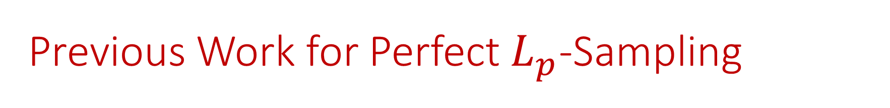

Previous Work for Perfect $L_{p}$-Sampling
$O\left(\log^{2}{n}\right)$ space perfect $L_{p}$ sampler for $p∈(0,2)$ and $O\left(\log^{3}{n}\right)$ space approximate $L_{p}$ sampler for $p=2$ [JayaramWoodruff18]
Notes:
The sliding window model emphasizes recent data and thus is appropriate for settings that are time sensitive.

Slide 17
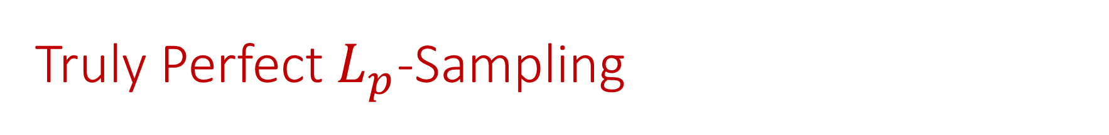
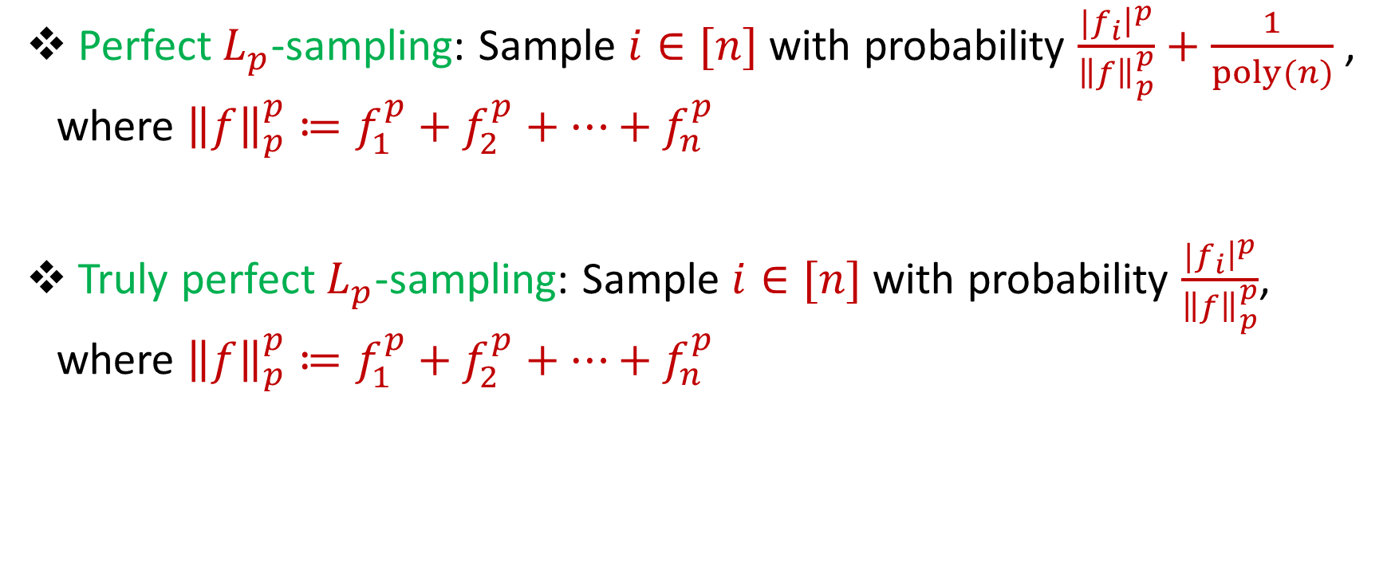
Truly Perfect $L_{p}$-Sampling
Perfect $L_{p}$-sampling: Sample $i∈[n]$with probability $\frac{{|f}_{i}{\left.​\right|}^{p}}{{\left\|f\right\|}_{p}^{p}}+\frac{1}{poly(n)}$ , where ${\left\|f\right\|}_{p}^{p}≔f_{1}^{p}+f_{2}^{p}+…+f_{n}^{p}$
Truly perfect${ L}_{p}$-sampling: Sample $i∈[n]$with probability $\frac{{|f}_{i}{\left.​\right|}^{p}}{{\left\|f\right\|}_{p}^{p}}$, where ${\left\|f\right\|}_{p}^{p}≔f_{1}^{p}+f_{2}^{p}+…+f_{n}^{p}$
Notes:
The sliding window model emphasizes recent data and thus is appropriate for settings that are time sensitive.

Slide 18
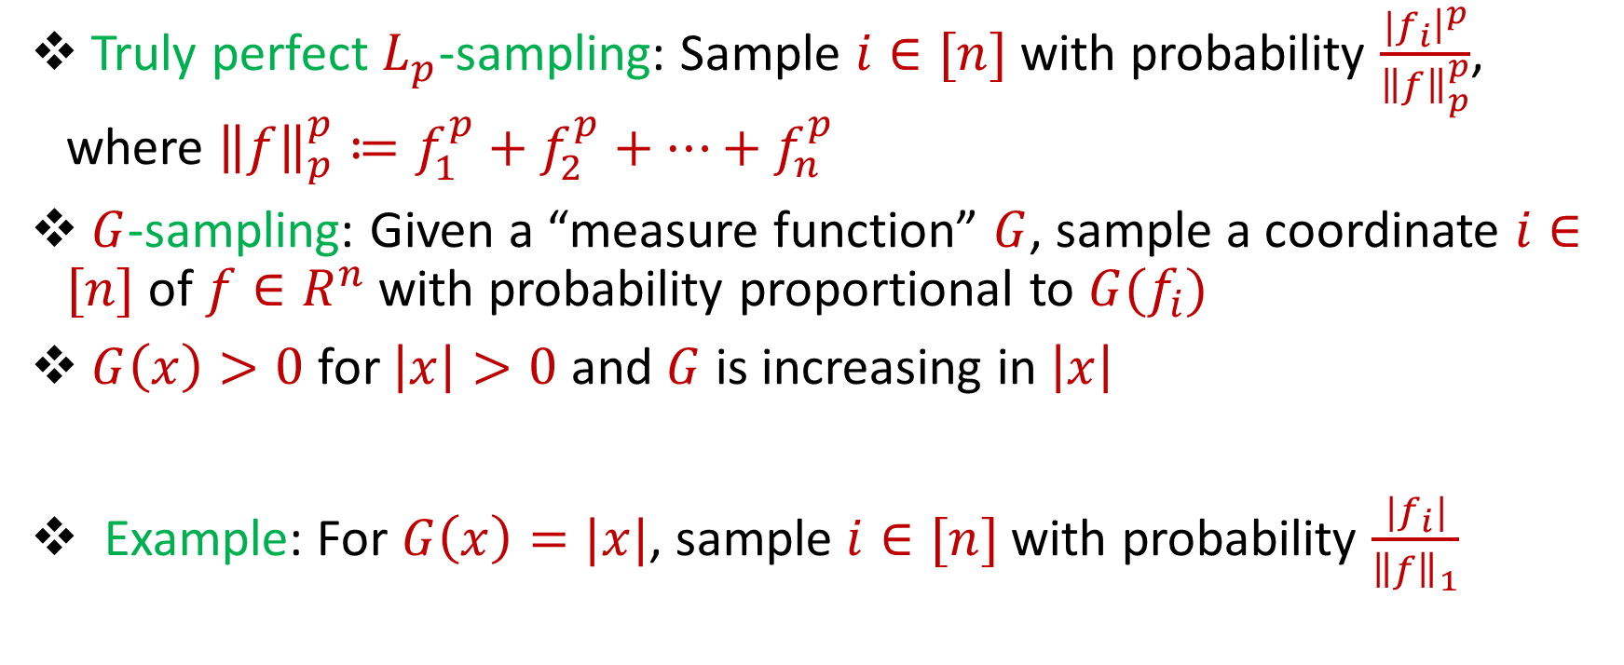
Truly Perfect Sampling
Truly perfect $L_{p}$-sampling: Sample $i∈[n]$with probability $\frac{{|f}_{i}{\left.​\right|}^{p}}{{\left\|f\right\|}_{p}^{p}}$, where ${\left\|f\right\|}_{p}^{p}≔f_{1}^{p}+f_{2}^{p}+…+f_{n}^{p}$
$G$-sampling: Given a “measure function” $G$, sample a coordinate $i∈[n]$of $f∈R^{n}$with probability proportional to ${G(f}_{i})$
$G\left(x\right)>0$ for $\left|x\right|>0$ and $G$ is increasing in $\left|x\right|$
Example: For $G\left(x\right)=|x|$, sample $i∈[n]$with probability $\frac{{|f}_{i}|}{{\left\|f\right\|}_{1}}$
Notes:
The sliding window model emphasizes recent data and thus is appropriate for settings that are time sensitive.

Slide 19
Motivation
Failure probability could lead to biases, which could add up
Previous samples can influence future samples, e.g., stochastic gradient descent
Many independent samplers run locally on disjoint portions of a large database
Notes:
The sliding window model emphasizes recent data and thus is appropriate for settings that are time sensitive.

Slide 20
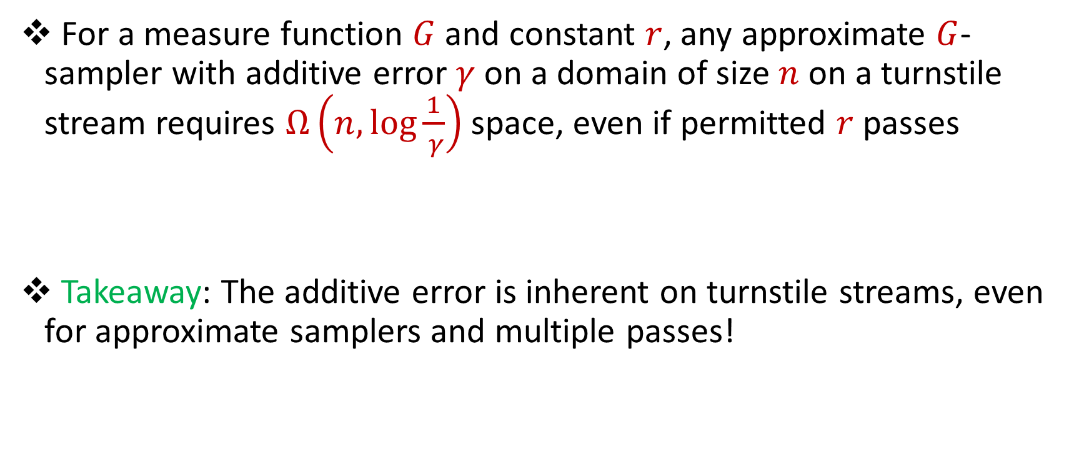
Our Results (I): Lower Bounds for Turnstile Streams
For a measure function $G$ and constant $r$, any approximate $G$-sampler with additive error $γ$ on a domain of size $n$ on a turnstile stream requires $Ω\left(n,\log{\frac{1}{ γ}}\right)$ space, even if permitted $r$ passes
Takeaway: The additive error is inherent on turnstile streams, even for approximate samplers and multiple passes!
Notes:
The sliding window model emphasizes recent data and thus is appropriate for settings that are time sensitive.

Slide 21
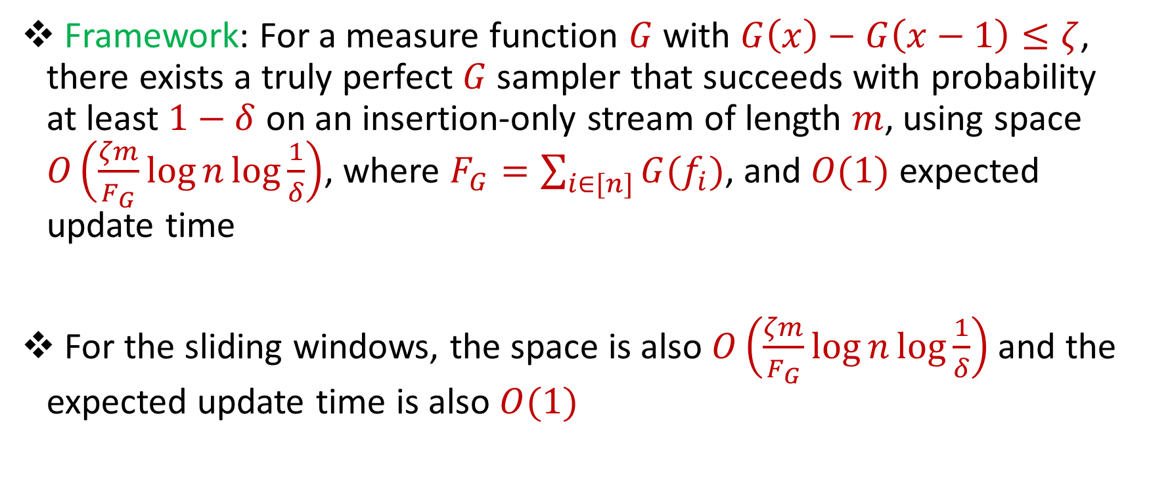
Our Results (II): Framework for Insertion-Only Streams
Framework: For a measure function $G$ with $G\left(x\right)−G\left(x−1\right)≤ζ$, there exists a truly perfect $G$ sampler that succeeds with probability at least $1−δ$ on an insertion-only stream of length $m$, using space $O\left(\frac{ζm}{F_{G}}\log{n\log{\frac{1}{δ}}}\right)$, where $F_{G}=\sum_{i∈[n]}{G(f_{i})}$, and $O(1)$ expected update time
For the sliding windows, the space is also $O\left(\frac{ζm}{F_{G}}\log{n\log{\frac{1}{δ}}}\right)$and the expected update time is also $O(1)$
Notes:
The sliding window model emphasizes recent data and thus is appropriate for settings that are time sensitive.

Slide 22
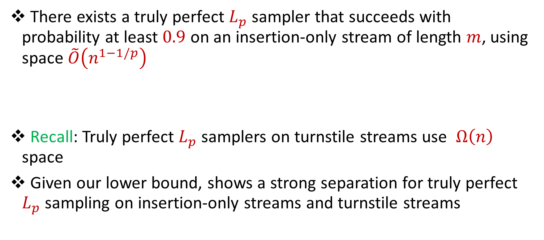
Framework Application (I)
There exists a truly perfect $L_{p}$ sampler that succeeds with probability at least $0.9$ on an insertion-only stream of length $m$, using space $\tilde{O}\left(n^{1−1/p}\right)$
Recall: Truly perfect $L_{p}$ samplers on turnstile streams use $Ω\left(n\right)$ space
Given our lower bound, shows a strong separation for truly perfect $L_{p}$ sampling on insertion-only streams and turnstile streams
Notes:
The sliding window model emphasizes recent data and thus is appropriate for settings that are time sensitive.

Slide 23
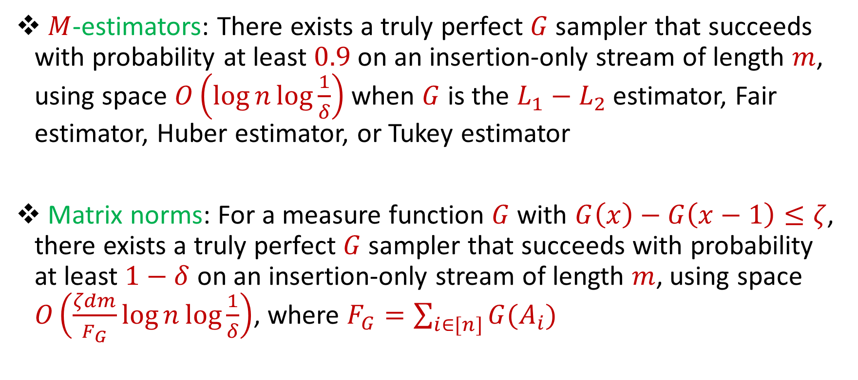
Framework Application (II)
$M$-estimators: There exists a truly perfect $G$ sampler that succeeds with probability at least $0.9$ on an insertion-only stream of length $m$, using space $O\left(\log{n\log{\frac{1}{δ}}}\right)$ when $G$ is the $L_{1}−L_{2}$ estimator, Fair estimator, Huber estimator, or Tukey estimator
Matrix norms: For a measure function $G$ with $G\left(x\right)−G\left(x−1\right)≤ζ$, there exists a truly perfect $G$ sampler that succeeds with probability at least $1−δ$ on an insertion-only stream of length $m$, using space $O\left(\frac{ζdm}{F_{G}}\log{n\log{\frac{1}{δ}}}\right)$, where $F_{G}=\sum_{i∈[n]}{G(A_{i})}$
Notes:
The sliding window model emphasizes recent data and thus is appropriate for settings that are time sensitive.

Slide 24

Our Results (III): Strict Turnstile Streams
Suppose there exists a truly perfect $L_{p}$ sampler for one-pass insertion-only stream that uses $S$ bits of space. Then there exists a truly perfect $L_{p}$ sampler for strict turnstile streams that uses $\tilde{O}(Sn^{γ})$ space and $O\left(\frac{1}{γ}\right)$ passes
Notes:
The sliding window model emphasizes recent data and thus is appropriate for settings that are time sensitive.

Slide 25
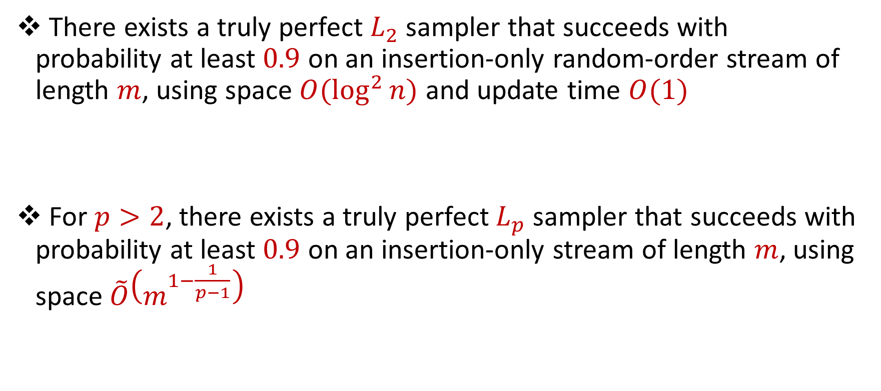
Our Results (IV): Random-Order Streams
There exists a truly perfect $L_{2}$ sampler that succeeds with probability at least $0.9$ on an insertion-only random-order stream of length $m$, using space $O(\log^{2}{n)}$ and update time $O(1)$
For $p>2$, there exists a truly perfect $L_{p}$ sampler that succeeds with probability at least $0.9$ on an insertion-only stream of length $m$, using space $\tilde{O}\left(m^{1−\frac{1}{p−1}}\right)$
Notes:
The sliding window model emphasizes recent data and thus is appropriate for settings that are time sensitive.

Slide 26
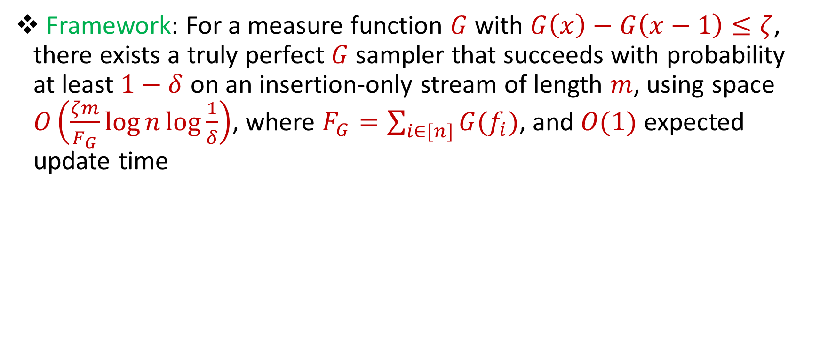
Framework for Insertion-Only Streams
Framework: For a measure function $G$ with $G\left(x\right)−G\left(x−1\right)≤ζ$, there exists a truly perfect $G$ sampler that succeeds with probability at least $1−δ$ on an insertion-only stream of length $m$, using space $O\left(\frac{ζm}{F_{G}}\log{n\log{\frac{1}{δ}}}\right)$, where $F_{G}=\sum_{i∈[n]}{G(f_{i})}$, and $O(1)$ expected update time
Notes:
The sliding window model emphasizes recent data and thus is appropriate for settings that are time sensitive.

Slide 27

Framework for Insertion-Only Streams
Reservoir sampling: At each time $t$, replace the sample with the most recent update, with probability $\frac{1}{t}$. Otherwise, keep the old sample
Samples each stream update with probability $\frac{1}{m}$
Notes:
The sliding window model emphasizes recent data and thus is appropriate for settings that are time sensitive.

Slide 28
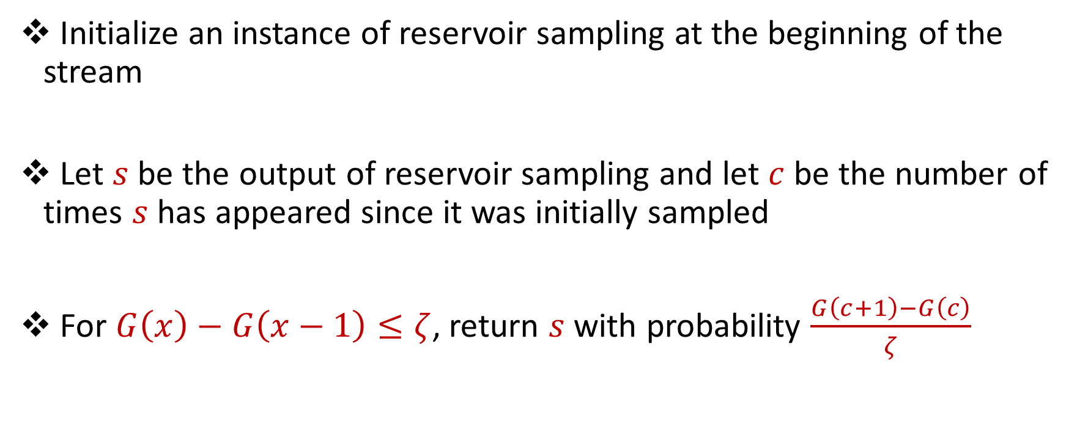
Framework for Insertion-Only Streams
Initialize an instance of reservoir sampling at the beginning of the stream
Let $s$ be the output of reservoir sampling and let $c$ be the number of times $s$ has appeared since it was initially sampled
For $G\left(x\right)−G\left(x−1\right)≤ζ$, return $s$ with probability $\frac{G\left(c+1\right)−G\left(c\right)}{ζ}$
Notes:
The sliding window model emphasizes recent data and thus is appropriate for settings that are time sensitive.

Slide 29
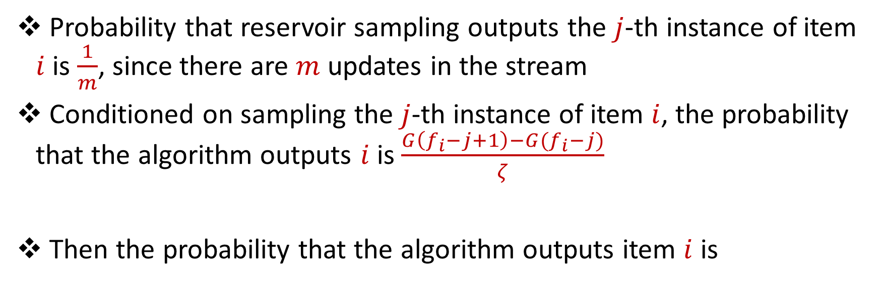
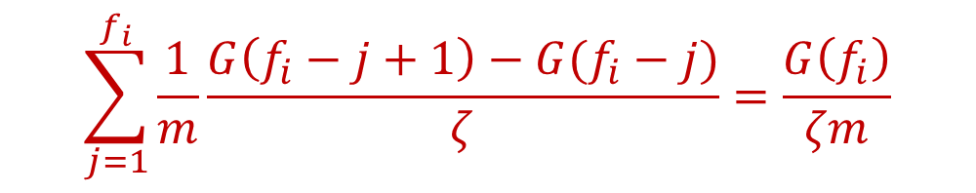
Framework for Insertion-Only Streams
Probability that reservoir sampling outputs the $j$-th instance of item $i$ is $\frac{1}{m}$, since there are $m$ updates in the stream
Conditioned on sampling the $j$-th instance of item $i$, the probability that the algorithm outputs $i$ is $\frac{G\left(f_{i}−j+1\right)−G(f_{i}−j)}{ζ}$
Then the probability that the algorithm outputs item $i$ is
$$\sum_{j=1}^{f_{i}}{\frac{1}{m}\frac{G\left(f_{i}−j+1\right)−G(f_{i}−j)}{ζ}}=\frac{G\left(f_{i}\right)}{ζm}$$
Notes:
The sliding window model emphasizes recent data and thus is appropriate for settings that are time sensitive.

Slide 30

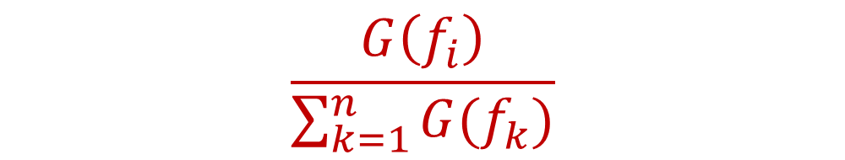
Framework for Insertion-Only Streams
The probability that the algorithm outputs item $i$ is $\frac{G\left(f_{i}\right)}{ζm}$
Conditioned on the algorithm outputting a coordinate, the probability that the algorithm outputs item $i$ is
But how likely is the algorithm to fail, i.e., not output anything?
$$\frac{G\left(f_{i}\right)}{\sum_{k=1}^{n}{G(f_{k})}}$$
Notes:
The sliding window model emphasizes recent data and thus is appropriate for settings that are time sensitive.

Slide 31
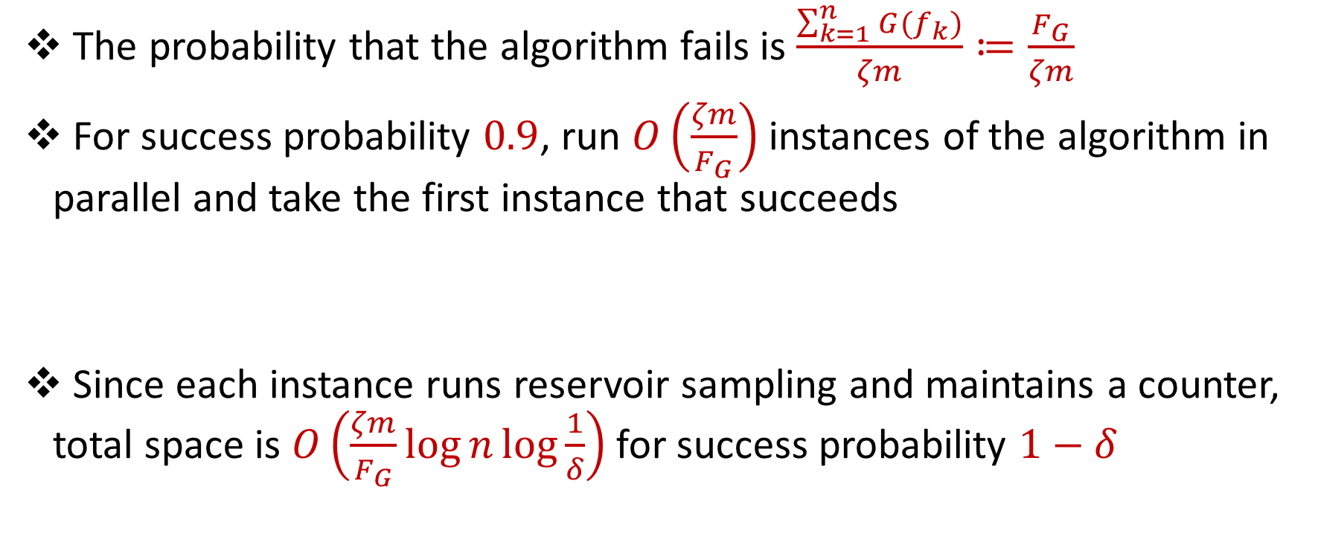
Framework for Insertion-Only Streams
The probability that the algorithm fails is $\frac{\sum_{k=1}^{n}{G(f_{k})}}{ζm}≔\frac{F_{G}}{ζm}$
For success probability $0.9$, run $O\left(\frac{ζm}{F_{G}}\right)$ instances of the algorithm in parallel and take the first instance that succeeds
Since each instance runs reservoir sampling and maintains a counter, total space is $O\left(\frac{ζm}{F_{G}}\log{n\log{\frac{1}{δ}}}\right)$ for success probability $1−δ$
Notes:
The sliding window model emphasizes recent data and thus is appropriate for settings that are time sensitive.

Slide 32
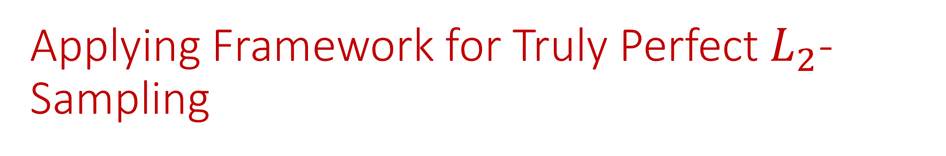
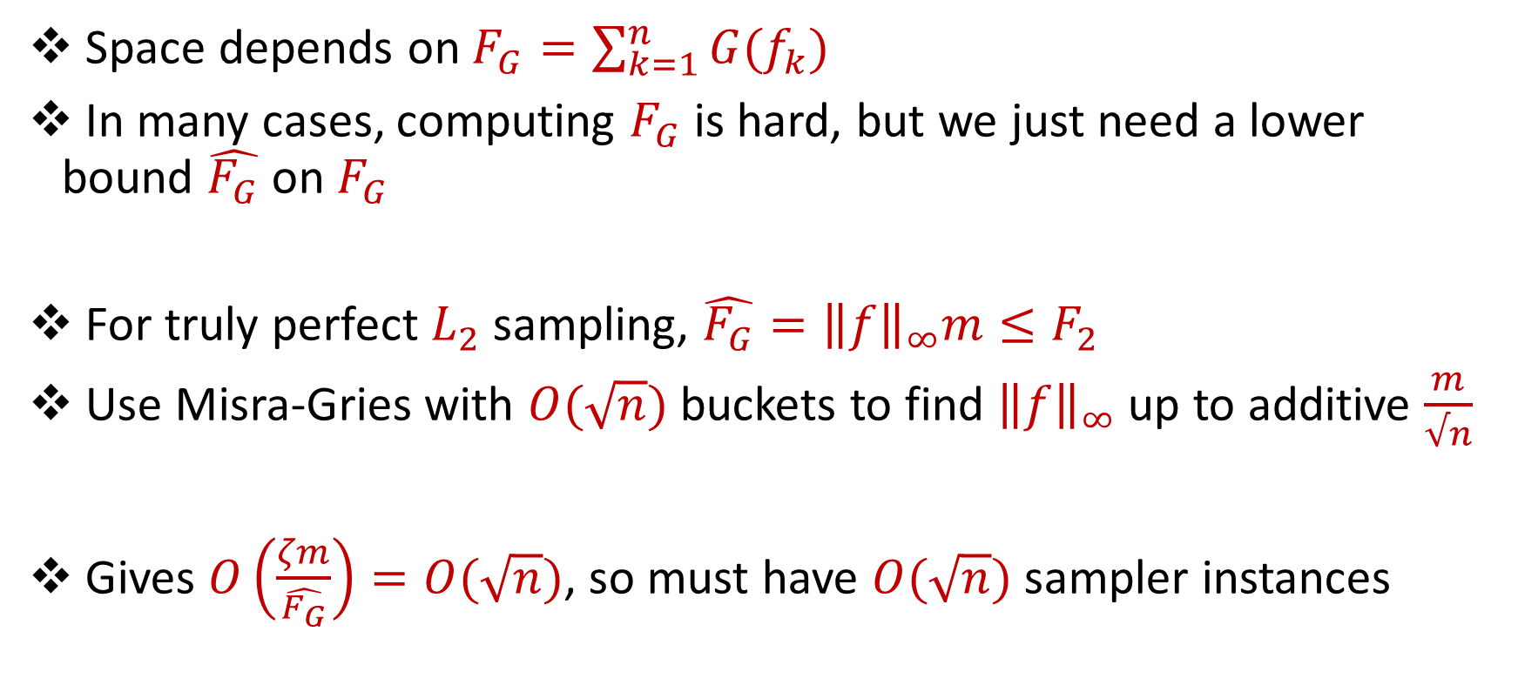
Applying Framework for Truly Perfect $L_{2}$-Sampling
Space depends on $F_{G}=\sum_{k=1}^{n}{G(f_{k})}$
In many cases, computing $F_{G}$ is hard, but we just need a lower bound $\hat{F_{G}}$ on $F_{G}$
For truly perfect $L_{2}$ sampling, $\hat{F_{G}}={\left\|f\right\|}_{∞}m≤F_{2}$
Use Misra-Gries with $O(\sqrt{n})$ buckets to find ${\left\|f\right\|}_{∞}$ up to additive $\frac{m}{√n}$
Gives $O\left(\frac{ζm}{\hat{F_{G}}}\right)=O(\sqrt{n})$, so must have $O(\sqrt{n})$ sampler instances
Notes:
The sliding window model emphasizes recent data and thus is appropriate for settings that are time sensitive.

Slide 33
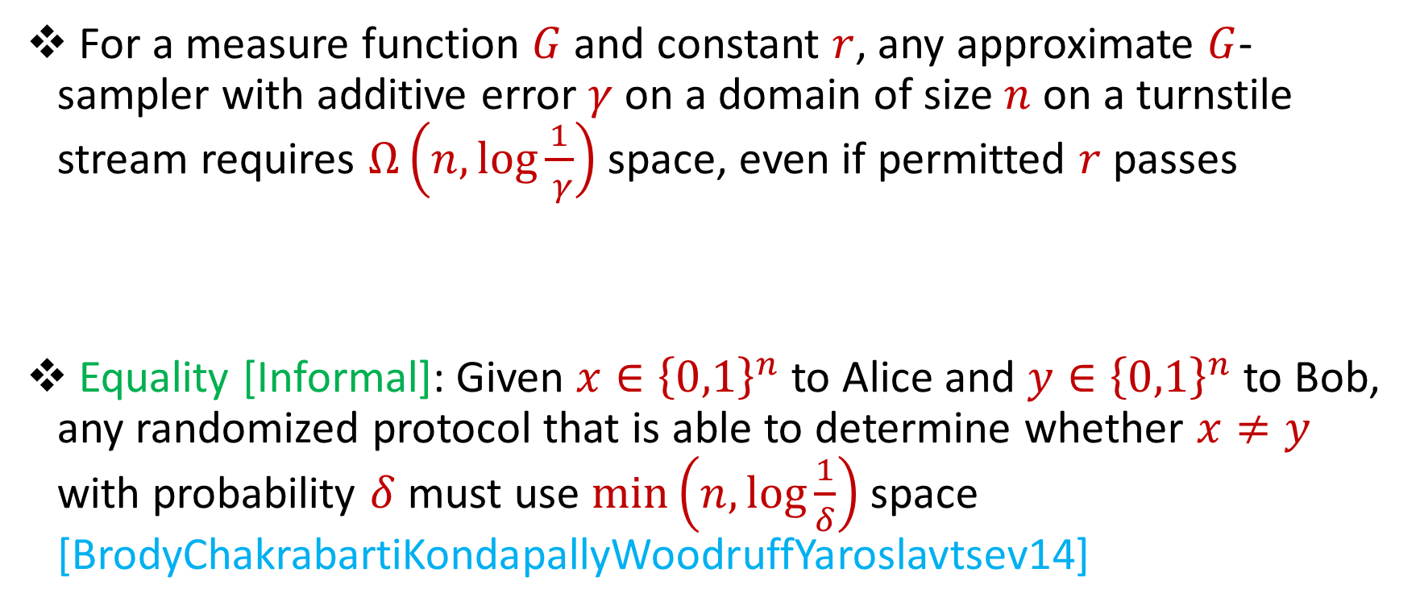
Lower Bounds for Turnstile Streams
For a measure function $G$ and constant $r$, any approximate $G$-sampler with additive error $γ$ on a domain of size $n$ on a turnstile stream requires $Ω\left(n,\log{\frac{1}{ γ}}\right)$ space, even if permitted $r$ passes
Equality [Informal]: Given $x∈{\left\{0,1\right\}}^{n}$ to Alice and $y∈{\left\{0,1\right\}}^{n}$ to Bob, any randomized protocol that is able to determine whether $x≠y$ with probability $δ$ must use $\min\left(n,\log{\frac{1}{δ}}\right)$ space [BrodyChakrabartiKondapallyWoodruffYaroslavtsev14]
Notes:
The sliding window model emphasizes recent data and thus is appropriate for settings that are time sensitive.

Slide 34
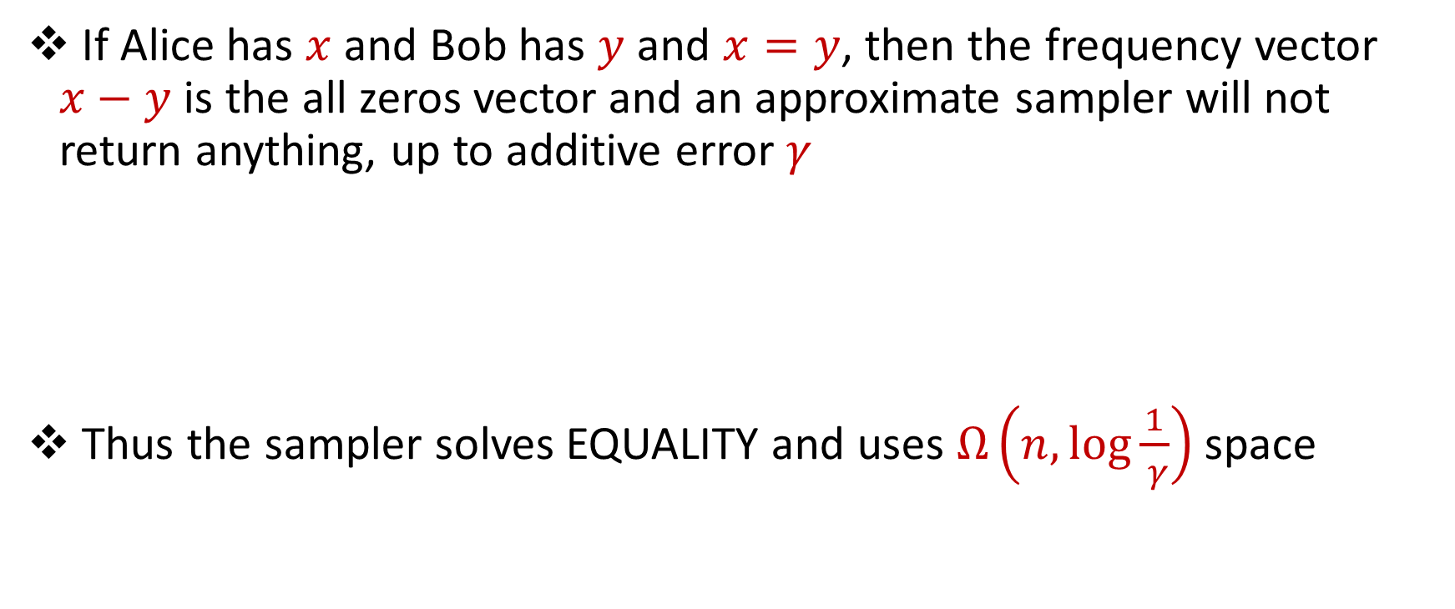
Lower Bounds for Turnstile Streams
If Alice has $x$ and Bob has $y$ and $x=y$, then the frequency vector $x−y$ is the all zeros vector and an approximate sampler will not return anything, up to additive error $γ$
Thus the sampler solves EQUALITY and uses $Ω\left(n,\log{\frac{1}{ γ}}\right)$ space
Notes:
The sliding window model emphasizes recent data and thus is appropriate for settings that are time sensitive.

Slide 35

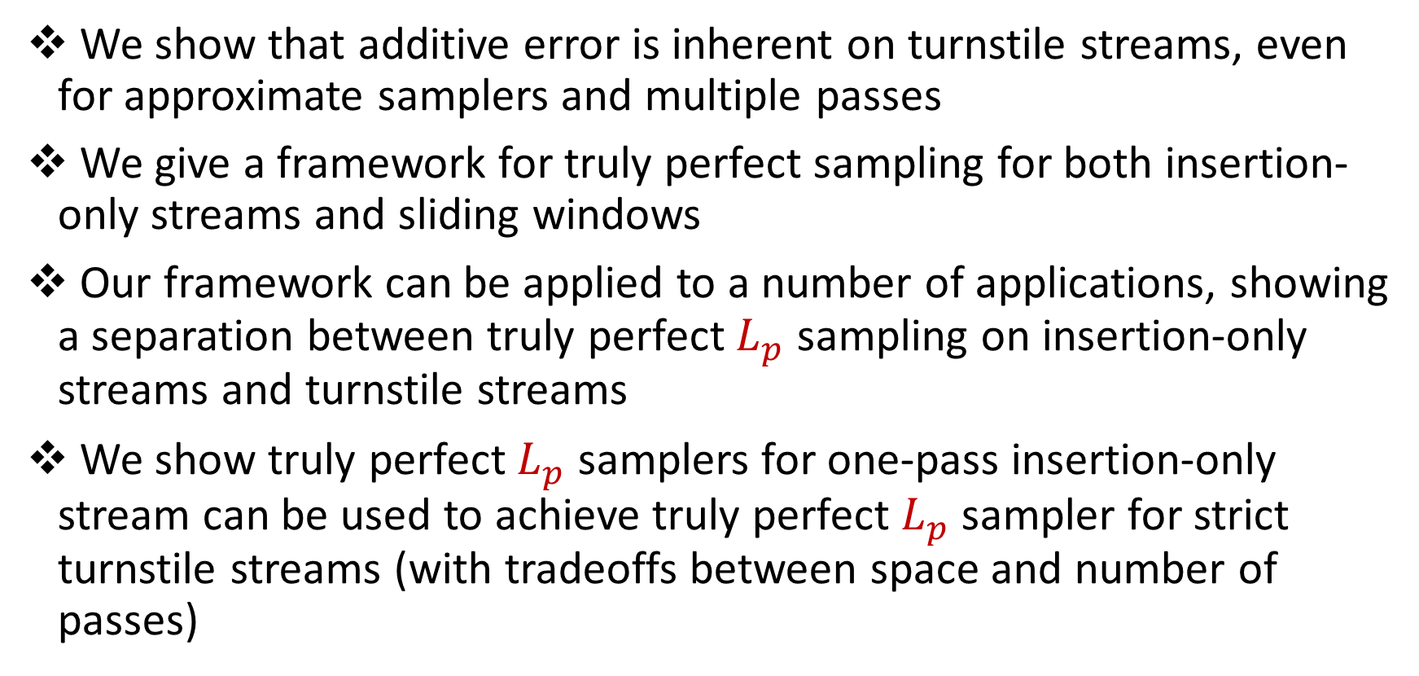
Summary
We show that additive error is inherent on turnstile streams, even for approximate samplers and multiple passes
We give a framework for truly perfect sampling for both insertion-only streams and sliding windows
Our framework can be applied to a number of applications, showing a separation between truly perfect $L_{p}$ sampling on insertion-only streams and turnstile streams
We show truly perfect $L_{p}$ samplers for one-pass insertion-only stream can be used to achieve truly perfect $L_{p}$ sampler for strict turnstile streams (with tradeoffs between space and number of passes)

Slide 36

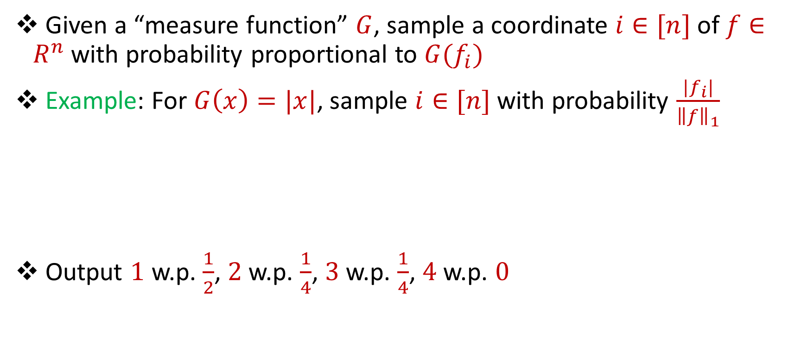
$L_{1}$-Sampling
Given a “measure function” $G$, sample a coordinate $i∈[n]$of $f∈R^{n}$with probability proportional to ${G(f}_{i})$
Example: For $G\left(x\right)=|x|$, sample $i∈[n]$with probability $\frac{{|f}_{i}|}{{\left\|f\right\|}_{1}}$
Output $1$ w.p. $\frac{1}{2}$, $2$ w.p. $\frac{1}{4}$, $3$ w.p. $\frac{1}{4}$, $4$ w.p. $0$
1 1 2 1 2 1 1 1 3 3  $\left[4, 2, 2, 0\right]≔f$
Notes:
The sliding window model emphasizes recent data and thus is appropriate for settings that are time sensitive.

